Slide 1
TIME TRAVEL:
PROCESSES & PARADOXES
Peter B. M. Vranas
University of Wisconsin-Madison
8 November 2018
Notes:
I am very excited to give this talk on time travel, which is one of my favorite topics.

Slide 2
MULTIPLE- VERSUS SINGLE-
UNIVERSE TIME TRAVEL
Universe #1 I am born I get married
(our universe) 1965 2017
Universe #2 I am born
(never married) 1965 2017
Universe #3 I am born
(born later) 1965 2017
Universe #4 I don’t exist
(never born) 1965 2017
Notes:
I would like to start by explaining an important distinction between two kinds of time travel: multiple-universe time travel and single-universe time travel. In multiple-universe time travel, it is assumed that there are multiple universes. For example, in universe #1, our universe, I was in born in 1965 and I got married in 2017. In another universe, universe #2, I am again born in 1965, but I never get married. In yet another universe, universe #3, I am born later, in 2017. In universe #4, I am never born: I don’t exist. And so on: the idea is that there are countless universes, which exist just like our universe exists. I am not saying that this idea is true: I am saying instead that this idea underlies many time travel stories. Strictly speaking, it is inaccurate to say that, for example, in universe #3 I am born in 2017: strictly speaking, in that universe someone else is born in 2017, someone who maybe looks exactly like me but still is not me: he is a copy or a counterpart of mine. I am only born in our universe: in other universes, my counterparts are born.

Slide 3
MULTIPLE-UNIVERSE
TIME TRAVEL
Hitler I am I enter a time
Our dies born machine
universe 1930 1945 1965 2018
I kill
Other Hitler
universe 1930
I don’t kill Hitler: I kill a counterpart of Hitler.
Notes:
In multiple-universe time travel, one travels between universes, from one universe to another. Suppose, for example, that in the year 2018 of our universe I enter a time machine, determined to go back in time and kill Hitler in 1930, before he does the awful things that he in fact did. In our universe, Hitler did not die in 1930: we are told that he died in 1945, committing suicide. But those who believe in multiple universes will say that there is another universe in which Hitler does die in 1930, killed by a time traveler. So I travel with my time machine to 1930 in such a universe, and I kill Hitler. Note, however, that there is something unsatisfactory with this kind of time travel. Strictly speaking, I don’t kill Hitler: I kill instead a counterpart of Hitler. In our universe, the actual Hitler lives beyond 1930 and does a lot of awful things. I plan to say more about this kind of time travel later on in the talk, but for the moment I just want to contrast it with another kind of time travel, single-universe time travel.

Slide 4
SINGLE-UNIVERSE
TIME TRAVEL
I try but
fail to Hitler I am I enter a time
Our kill Hitler dies born machine
universe 1930 1945 1965 2018
Since Hitler in our universe is not killed in 1930, my plan to kill him in 1930 will fail.
Notes:
In single-universe time travel, one travels from one time to another in the same universe. Suppose again that in the year 2018 of our universe I enter a time machine, determined to go back in time and kill Hitler in 1930. If there is only one universe, or if there are multiple universes but for some reason I can only travel within our universe, then, when I exit my time machine in 1930, my plan will fail: there is no way I will manage to kill Hitler in 1930 in our universe, since in our universe Hitler was not killed in 1930. If there is only one universe, with a single timeline, then it is a contradiction to say that in that universe there is a first 1930, in which Hitler is not killed, and a second 1930, in which Hitler is killed. Some time travel stories do say things like this, but the fact that there are self-contradictory time travel stories does not mean that they correspond to a possible kind of time travel. Most of my talk is about single-universe time travel, because this is the kind of time travel on which the philosophical literature has mainly focused.

Slide 5
WHAT KIND OF TIME TRAVEL
IS A STORY ABOUT?
Suppose a time traveler starts now in our universe and goes back to 1930.
If things look very different from the actual 1930 (e.g., there are smartphones), it’s multiple-universe time travel.
If things look just as in the actual 1930, you can’t tell what kind of time travel the story is about. But you may get hints as the story unfolds.
Notes:
When you are reading a time travel story or you are watching a time travel movie, how can you tell whether it is about multiple-universe or single-universe time travel? In some cases, it is easy to tell. Suppose a time traveler starts now in our universe and goes back to 1930, but things look there very different from the actual 1930: there are smartphones and laptops everywhere. Then you know that the time traveler has reached 1930 in a different universe, and the story is about multiple-universe time travel. But in other cases it is very hard to tell, at least initially. If a time traveler exits a time machine in 1930 and things look there just as they looked in the actual 1930, then you don’t know whether the time traveler has reached 1930 in our universe or in a different universe. As the story unfolds, however, you may get some hints. For example, if the time traveler repeatedly tries to kill Hitler but always fails, this suggests that the story is about single-universe time travel. Alternatively, if something happens that you know did not happen in the actual 1930, for example Hitler is severely wounded, this suggests that the story is about multiple-universe time travel. Now that you are aware of the distinction, you can be alert every time you watch a time travel movie: you can try to find out whether it is about multiple-universe or single-universe time travel. I think this makes such movies more fun to watch.

Slide 6
OVERVIEW
I. SINGLE-UNIVERSE TIME TRAVEL
1. Defining Time Travel
2. Three Time Travel Processes
    Time jumps
    Time slides
    Wormholes
3. Two Time Travel Paradoxes
II. MULTIPLE-UNIVERSE TIME TRAVEL
Notes:
Having gotten this distinction out of the way, here is my plan for the rest of the talk. Most of the talk will be about single-universe time travel. First, I plan to define this kind of time travel carefully. Second, I plan to go over three time travel processes: time jumps, time slides, and wormholes. Third, I plan to address two paradoxes associated with this kind of time travel. Finally, in the last part of the talk, I plan to examine multiple-universe time travel. From now on, and until we get to the last part, whenever I talk about time travel, you should understand me as talking about single-universe time travel: I will be assuming that there is only one universe, our universe, with a single timeline.

Slide 7
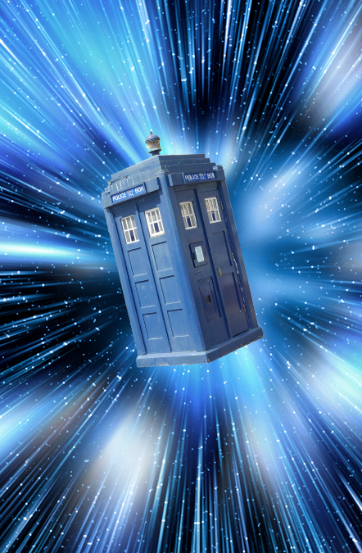
TIME TRAVEL TO THE PAST
Something travels to the past if and only if its arrival is earlier than its departure.
This definition applies not only to people but also to inanimate objects, subatomic particles, light, energy, information, etc.
Notes:
Let’s start with the first task, which is to define time travel carefully. There are two kinds of single-universe time travel: time travel to the past, and time travel to the future. Consider first time travel to the past. This kind of time travel seems easy to define: something travels to the past if and only if its arrival is earlier than its departure. For example, if you depart today and you arrive yesterday, then you have traveled to the past. This definition applies to anything that might travel: not only people, but also inanimate objects, subatomic particles, light, energy, information, and so on. There is a complication, however. According to the Special Theory of Relativity, whether an event is earlier or later than another is in general a relative matter. In some cases, your arrival is earlier than your departure according to one observer, but your arrival is later than your departure according to another observer. I will ignore this complication in what follows. If you are interested, we can discuss during the question period how to define time travel in Special Relativity.

Slide 8
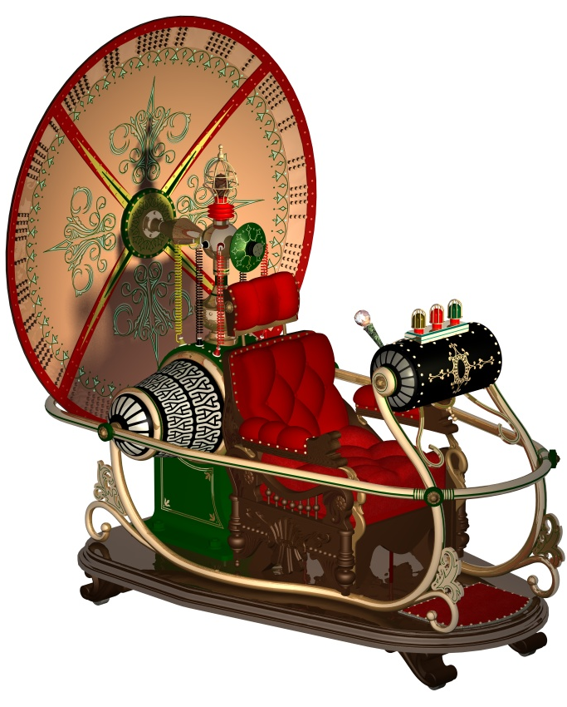
TIME TRAVEL TO THE FUTURE
Bad definition: Something travels to the future if and only if its arrival is later than its departure.
On this definition, any ordinary trip is time travel to the future: if you walk to school, your arrival is later than your departure.
Notes:
Consider next how to define time travel to the future. Here is a bad definition: something travels to the future if and only if its arrival is later than its departure. This definition is bad because it counts any ordinary trip as time travel to the future: if you walk to school, your arrival is later than your departure, so according to this definition you travel to the future. But this is not what we mean when we talk about traveling to the future. To see what we mean, let’s watch a clip from the movie The Time Machine.

Slide 9
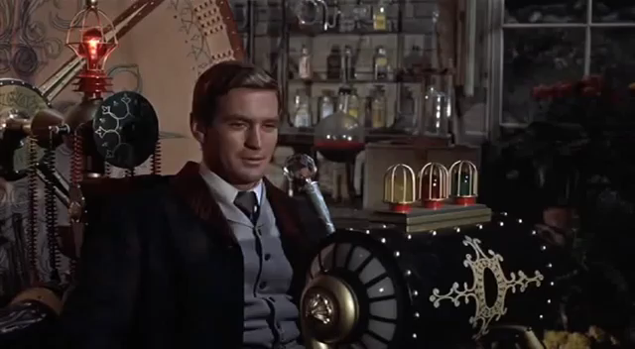
THE TIME MACHINE (1960)
Notes:
In this clip, the traveler experiences his hands as moving at their ordinary speed inside the time machine, but experiences the world outside the machine as a film running at high speed. The trip takes maybe a couple of minutes from the perspective of the traveler, but takes several days from the perspective of the world outside the machine.

Slide 10
TIME TRAVEL TO THE FUTURE:
A BETTER DEFINITION
External duration of a trip: The difference between the arrival and the departure time.
Stopwatch duration of a trip: The length of time that would be measured by a properly function-ing stopwatch accompanying the traveler.
Better definition: Something travels to the future if and only if the stopwatch duration of its trip is shorter than the external duration of its trip.
Notes:
Let’s call the duration of the trip from the perspective of the world outside the machine the external duration of the trip: this is the difference between the arrival and the departure time of the traveler. Let’s also call the duration of the trip from the perspective of the traveler the stopwatch duration of the trip: this is the length of time that would be measured during the trip by a properly functioning stopwatch accompanying the traveler. What makes the trip in the clip we just watched a case of time travel to the future is that the stopwatch duration of the trip, which is maybe a couple of minutes, is shorter than the external duration of the trip, which is several days. This observation leads to the following better definition of time travel to the future: something travels to the future if and only if the stopwatch duration of its trip is shorter than the external duration of its trip. Again, there is a complication: according to the Special Theory of Relativity, different observers may disagree on how long your trip takes, so there is no such thing as the external duration of your trip. I will ignore this complication, which we can discuss during the question period if you are interested.

Slide 11
OVERVIEW
I. SINGLE-UNIVERSE TIME TRAVEL
1. Defining Time Travel
2. Three Time Travel Processes
    ⇒ Time jumps
    Time slides
    Wormholes
3. Two Time Travel Paradoxes
II. MULTIPLE-UNIVERSE TIME TRAVEL
Notes:
Having defined time travel, I turn to my next task, which is to go over three time travel processes: time jumps, time slides, and wormholes.

Slide 12
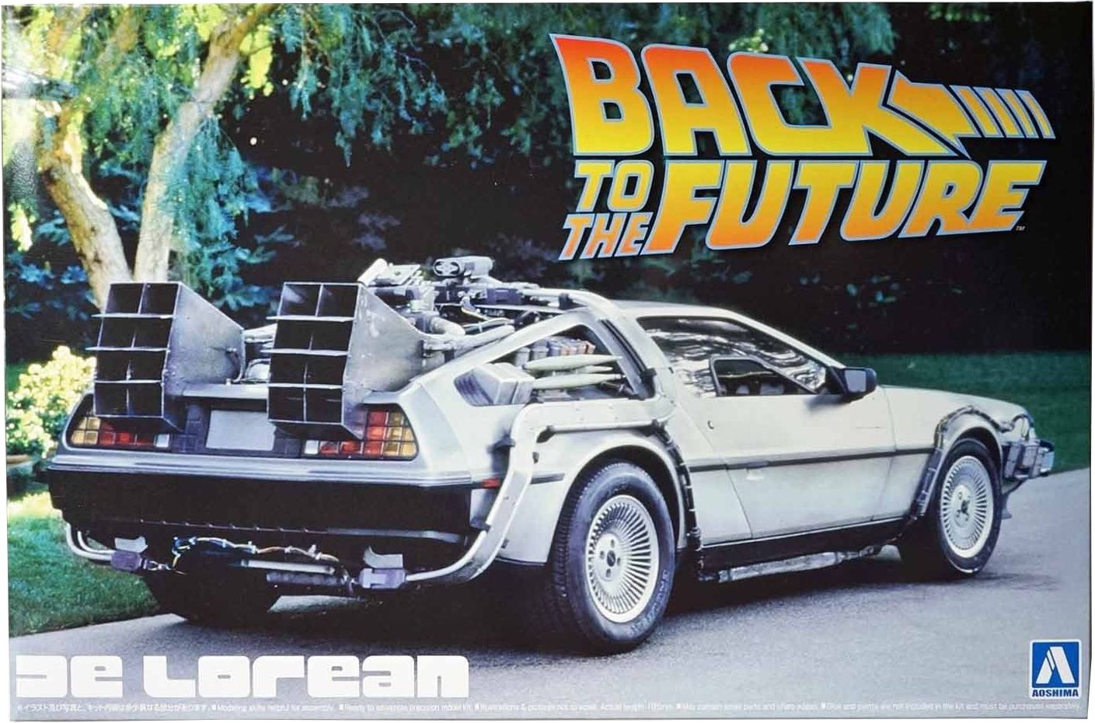
TIME JUMPS
A time jump is an instantaneous trip from one moment in time to another. The stopwatch duration of the trip is zero.
Notes:
Consider first time jumps. A time jump is an instantaneous trip from one moment in time to another. For example, I enter a sports car which is a time machine, I accelerate, I and the car vanish into thin air, and as a consequence we reappear out of the blue in another spacetime region.

Slide 13
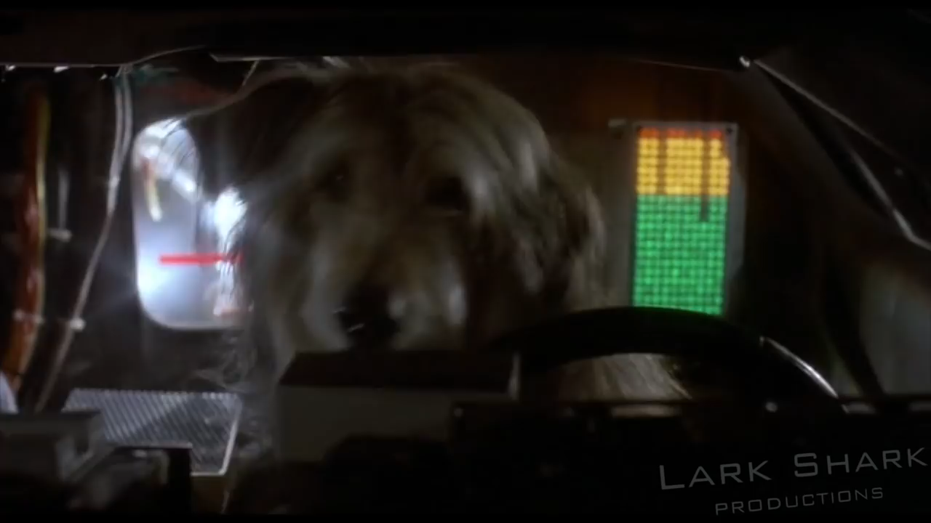
A TIME JUMP FROM AN
EXTERNAL PERSPECTIVE
Notes:
Here is what a time jump looks like from the perspective of external observers.

Slide 14
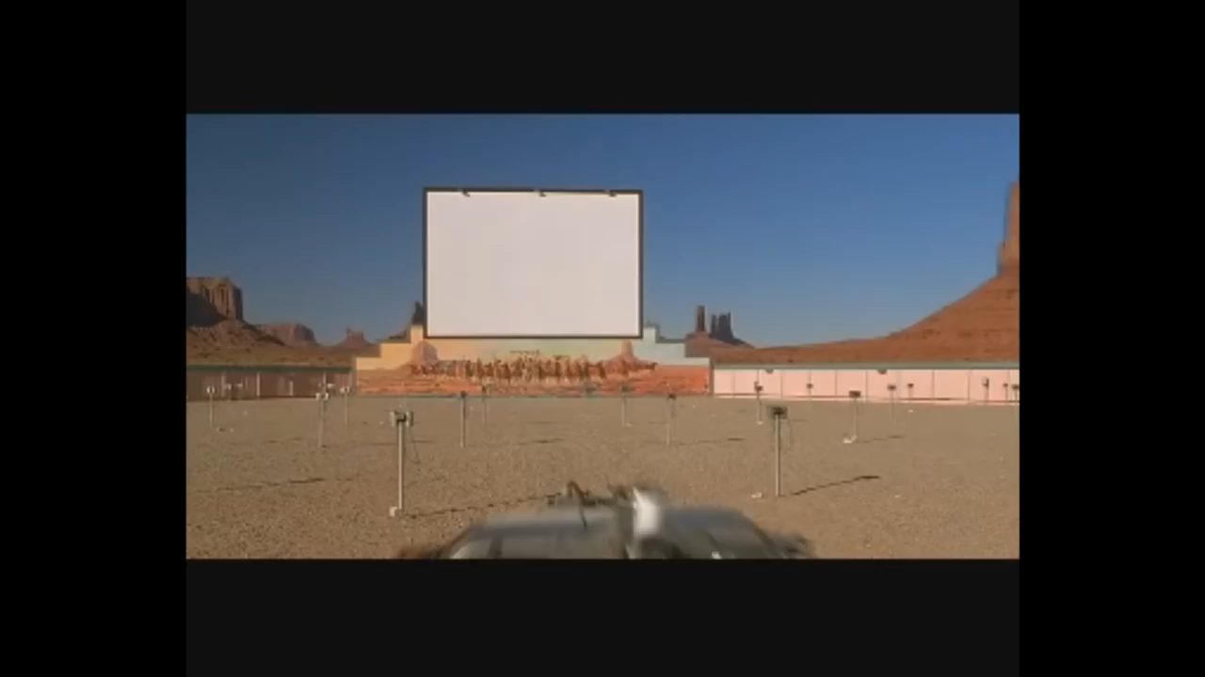
A TIME JUMP FROM AN
INTERNAL PERSPECTIVE
Notes:
Now here is what a time jump looks like from the perspective of the time traveler.
We see that the time jump is instantaneous from the perspective of the time traveler: one moment he is in 1955, and then suddenly he is in 1885, faced by Indians. The stopwatch duration of the trip is zero.

Slide 15
MASS-ENERGY
CONSERVATION
Problem: How are the sudden disappearance and reappearance of the time traveler consistent with the law of conservation of mass-energy?
Possible solution: At disappearance, the time traveler’s body is converted into energy. At reappearance, energy is converted into a qualitatively identical body.
Problem: No known physical process suddenly converts energy into a body.
Notes:
Although this kind of time travel is very popular in science fiction novels and movies, no known physical process corresponds to it. How are the time traveler’s disappearance from one time and reappearance at another time consistent with the law of conservation of mass-energy? One might argue that, when the time traveler disappears, his body is converted into energy, and when he reappears, energy is converted by a reverse process into a qualitatively identical new body. This would indeed be consistent with the law of conservation of mass-energy, but my point is that no known physical process corresponds to this sudden conversion of energy into a body. So time jumps are a merely theoretical possibility: they are not considered in the physics literature.

Slide 16
OVERVIEW
I. SINGLE-UNIVERSE TIME TRAVEL
1. Defining Time Travel
2. Three Time Travel Processes
    Time jumps
    ⇒ Time slides
    Wormholes
3. Two Time Travel Paradoxes
II. MULTIPLE-UNIVERSE TIME TRAVEL
Notes:
Consider next a second time travel process: time slides. The idea is that, instead of jumping from one moment in time to another, one gradually slides through time. A time slide to the past is not instantaneous: from the perspective of the traveler, the trip takes some time, and during that time the traveler experiences the world outside the time machine as a film running backwards. Here is an example.

Slide 17
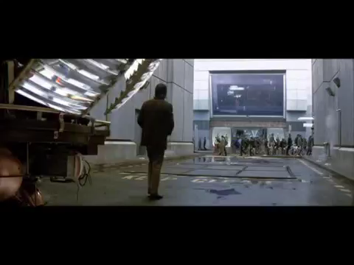
TIME SLIDES
Notes:
Note that during a time slide to the past the traveler is not becoming younger: the traveler continues to age. In science fiction, time slides are less popular than time jumps. In the philosophical literature, time slides are not considered seriously, because it is recognized that they run into a significant problem. The clip that we just watched is in fact inconsistent. Here is why.

Slide 18
A PROBLEM WITH
TIME SLIDES
The traveler enters the machine at noon.
Before noon, at 11:59 am, the machine is empty.
At noon, the machine with the traveler starts moving backwards in time, through 11:59 am, 11:58 am, etc.
So at 11:59 am the machine is not empty. Contradiction!
Notes:
In the beginning of the clip, the time machine is empty, and the traveler climbs into it. Then he pushes the lever, and the machine starts moving backwards in time. Suppose that he pushes the lever at noon. As we saw, one minute before, so at 11:59am, the machine was empty. At noon, the traveler is sitting inside the machine, so the machine is not empty. As the machine moves backwards in time, it goes to 11:59am, then 11:58am, and so on. At all those times, the traveler is still inside the machine, so the machine is not empty. But we just said that at 11:59am the machine was empty! So we have a contradiction: at 11:59am, the machine is both empty and not empty. At least, we have a contradiction if, as I have been assuming, only one universe exists, so that when the machine moves backwards in time it does not go through 11:59am in a different universe.

Slide 19
SOLUTION: MOVING MACHINE
12:00 pm
11:59 am
Empty Machine with
machine traveler inside
Left Right
At 11:59 am, there are two copies of the machine: an empty copy (not moving in space but moving forwards in time), and a copy with the traveler (moving in space and moving backwards in time).
Notes:
One might respond that the clip I showed you is inconsistent because the time machine is not moving in space, so at 11:59am it cannot be both empty and non-empty at the same place. One might think that there would be no problem if, when the traveler pushes the lever, the machine started moving in space in addition to moving backwards in time. In such a case, at 11:59am there would be two copies of the machine at different places: an empty copy moving forwards in time, and a non-empty copy moving backwards in time. This diagram explains the idea. At 11:59am, the machine is empty, and it is not moving in space: it is moving forwards in time. At noon, the traveler enters the machine, and the machine starts moving to the right in space and starts moving backwards in time. So at 11:59am the copy of the machine with the traveler inside is to the right of the empty copy of the machine, and there is no contradiction.

Slide 20

ANOTHER PROBLEM
WITH TIME SLIDES
12:00 pm
11:59 am
Empty Machine with
machine traveler inside
Left Right
When the “two” machines get close enough, they don’t collide: they gradually merge with each other, and when the merging is complete (at noon), the resulting single machine disappears.
Notes:
All this is well and good, but there is still a significant problem. Consider what an external observer sees as we get very close to noon. There is an empty machine which is not moving in space, and there is a machine with the traveler inside which is moving towards the empty machine. When the “two” machines get close enough, they don’t collide: they rather gradually merge with each other, and the moment the merging is complete, namely at noon, the resulting single machine disappears. To the extent that physical objects don’t behave like ghosts and must collide rather than merge, the physical possibility of time slides is questionable.

Slide 21
OVERVIEW
I. SINGLE-UNIVERSE TIME TRAVEL
1. Defining Time Travel
2. Three Time Travel Processes
    Time jumps
    Time slides
    ⇒ Wormholes
3. Two Time Travel Paradoxes
II. MULTIPLE-UNIVERSE TIME TRAVEL
Notes:
Consider finally a third way to travel through time: by means of wormholes. Time travel by wormholes is taken seriously by physicists because it may be allowed by the General Theory of Relativity.

Slide 22
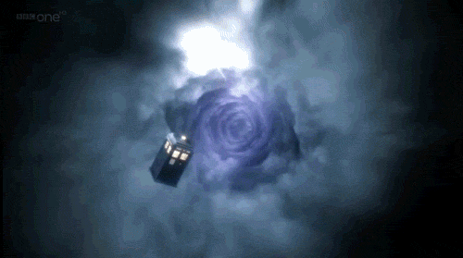
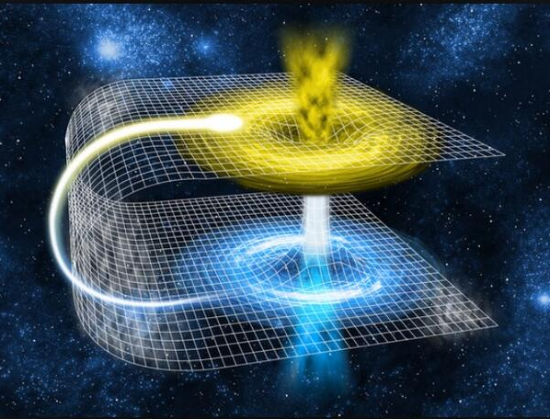
WORMHOLES
A wormhole is like a tunnel: it is a shortcut connecting two otherwise distant spacetime regions.
It has two entrances, or mouths, which look like spheres.
Notes:
A wormhole is like a tunnel: it is a shortcut that connects two otherwise distant spacetime regions. It has two entrances, or “mouths”, which look like spheres. The idea is that you enter one mouth, for example close to Earth, you travel through the tunnel for a few minutes, and you exit the other mouth at a distant galaxy. The trip to that galaxy would normally take many years; through the wormhole, it takes only a few minutes. Here is an example.

Slide 23
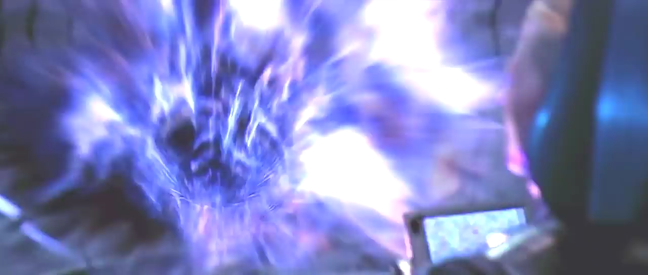
CONTACT (1997)
Notes:
We don’t know whether there are any wormholes in our universe, especially wormholes that humans could go through without being ripped apart. But they are definitely allowed by the General Theory of Relativity.

Slide 24
THE TWIN PARADOX
Consider two identical twins: Peter and Paul.
Peter stays on Earth, but Paul goes on a space trip to a distant galaxy and then comes back to Earth.
Then Paul has aged less than Peter: the stopwatch duration of Paul’s trip is shorter than its external duration in Earth time.
So Paul has traveled to the future.
Notes:
To explain how to construct a time machine by using a wormhole, I need to go first over the twin paradox. Consider two identical twins, Peter and Paul. One of them, Peter, stays here on Earth, and the other one, Paul, goes on a space trip to a distant galaxy and then comes back to Earth. Then the Special Theory of Relativity predicts, and indeed measurements have confirmed, that the twin who returns to Earth has aged less than the twin who stayed on Earth. Using the terminology that I introduced earlier, we can say that the stopwatch duration of the trip is shorter than the external duration, so the space-traveling twin has traveled to the future.

Slide 25
WORMHOLE TIME MACHINES:
PART 1
Consider a wormhole with one mouth in Boston and the other mouth in Detroit.
The trip through the wormhole takes 2 minutes.
We put the Boston mouth on a space ship, take it on a space trip, and return it to Boston.
Then, by the twin paradox, the Boston mouth has aged less than its surroundings that stayed in Boston: when in the rest of Boston it’s
12 pm, inside the Boston mouth it’s 8 am.
Notes:
Here is how to use the twin paradox to construct a wormhole time machine. Suppose that somewhere we have found a wormhole. To have a concrete example, suppose that one mouth of the wormhole is in Boston and the other mouth is in Detroit. Suppose also that the trip through the wormhole takes two minutes: if you enter the Boston mouth at 8am and you go through the wormhole, you emerge from the Detroit mouth at 8:02am. Similarly, if you enter in Detroit at 8am, you exit in Boston at 8:02am. Suppose finally that you can somehow move the Boston mouth: you put it on a spaceship, you take it to a distant galaxy, and then you return it to Boston. (I know that this sounds like science fiction, but I assure you that these ideas are seriously discussed in the most prestigious physics journals.) Then, by the reasoning of the twin paradox, the Boston mouth has aged less than its surroundings that stayed in Boston. (Recall that the twin who returns from a space trip has aged less than the twin who stayed on Earth.) This means that time inside the Boston mouth runs behind Boston time, which is Eastern Standard Time: for example, if in the rest of Boston it’s noon, inside the Boston mouth it’s 8am.

Slide 26
WORMHOLE TIME MACHINES:
PART 2
Now the wormhole functions like a time machine.
Start your trip in Boston at 12 pm by entering the Boston mouth.
Inside the Boston mouth it’s 8 am.
Go through the wormhole in 2 minutes and exit in Detroit at 8:02 am.
Catch a 9 am flight from Detroit and arrive in Boston at 11 am, before your trip started.
Notes:
Now the wormhole functions like a time machine. To see this, suppose that you start your trip in Boston at noon, by entering the Boston mouth. Inside the Boston mouth it’s 8am. You go through the wormhole in 2 minutes, and you emerge from the Detroit mouth at 8:02am. (Detroit is also in the Eastern time zone.) Then you go to the Detroit airport, you catch a 9am flight to Boston, and you arrive in Boston at 11am, before your departure, which was at noon. You have traveled to the past.

Slide 27
COMPARING THE THREE
TIME TRAVEL PROCESSES
 | Trajectory | Stopwatch duration | What you see during the trip
Time jump | Discontinuous | Zero | Nothing
Time slide | Continuous | Positive | Film played backwards
Wormhole | Continuous | Positive | Interior of tunnel
Notes:
Many physicists believe that this kind of time travel is possible, but others disagree. I am not going to enter into this debate here. Instead I want to note how this kind of time travel differs from time jumps and time slides. In a time jump, your trajectory is discontinuous: you suddenly disappear at one time and place, and you suddenly reappear at a different time and maybe also a different place. In wormhole time travel, by contrast, your trajectory is continuous: there is no sudden disappearance or reappearance. Moreover, a time jump is instantaneous: its stopwatch duration is zero. A trip through a wormhole, by contrast, may be very short but is not instantaneous: its stopwatch duration is positive, not zero. The stopwatch duration of a time slide is also positive, but during a time slide to the past you can experience the world outside the time machine as a film running backwards. In a trip through a wormhole, by contrast, you can hardly see the world outside the machine: the machine is the wormhole, which is like a tunnel, and you can only see the tunnel, and maybe what lies at its end.

Slide 28
OVERVIEW
I. SINGLE-UNIVERSE TIME TRAVEL
1. Defining Time Travel
2. Three Time Travel Processes
    Time jumps
    Time slides
    Wormholes
⇒ 3. Two Time Travel Paradoxes
II. MULTIPLE-UNIVERSE TIME TRAVEL
Notes:
I turn now to the next part of my talk, where I address two time travel paradoxes. Recall that I am still assuming there is only one universe, with a single timeline.

Slide 29
THE RETROSUICIDE
PARADOX
Suppose time travel to the past is possible.
Then I can travel to 1975 and point a gun at my 10-year-old younger self.
So I can kill my younger self. But I cannot kill my younger self, because he grew up to become me. Contradiction!
So time travel to the past is impossible.
Initial reply: If time travel is uncontrollable, then I cannot kill my younger self.
Notes:
A standard paradox of time travel goes roughly like this. Suppose that time travel to the past is possible. Then I can enter a time machine, travel to 1975, meet myself when I was a ten-year old boy, and point a loaded gun at the boy. So I can kill my younger self. But on the other hand, I cannot kill my younger self, because he lived and grew up to become me. So if time travel to the past is possible we get a contradiction: I both can and cannot kill my younger self. So time travel to the past is impossible, or so the paradox goes: as I will explain, I don’t agree. Let’s call this the “Retro-Suicide Paradox”. A well known variant is the “Grandfather Paradox”, which asks whether I can kill for example my paternal grandfather at a time before my father was conceived.
In reply to this paradox, I want to make first the point that, if time travel is uncontrollable, then I cannot kill my younger self. To explain what I mean by uncontrollable time travel, let’s watch a clip from the movie The Time Traveler’s Wife.

Slide 30
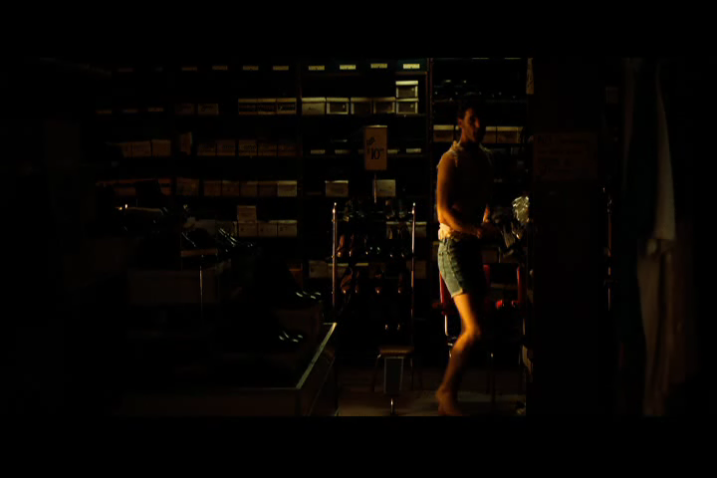
UNCONTROLLABLE
TIME TRAVEL
Notes:
In this clip, the time traveler cannot control anything: he cannot control when his trips start, when or where he goes, whether he goes to the past or to the future, or how long he stays there. He can’t even take anything with him: he travels naked, and he has the problem of finding clothes wherever he arrives. This is uncontrollable time travel. Let’s contrast this with the kind of time travel in the next clip.

Slide 31
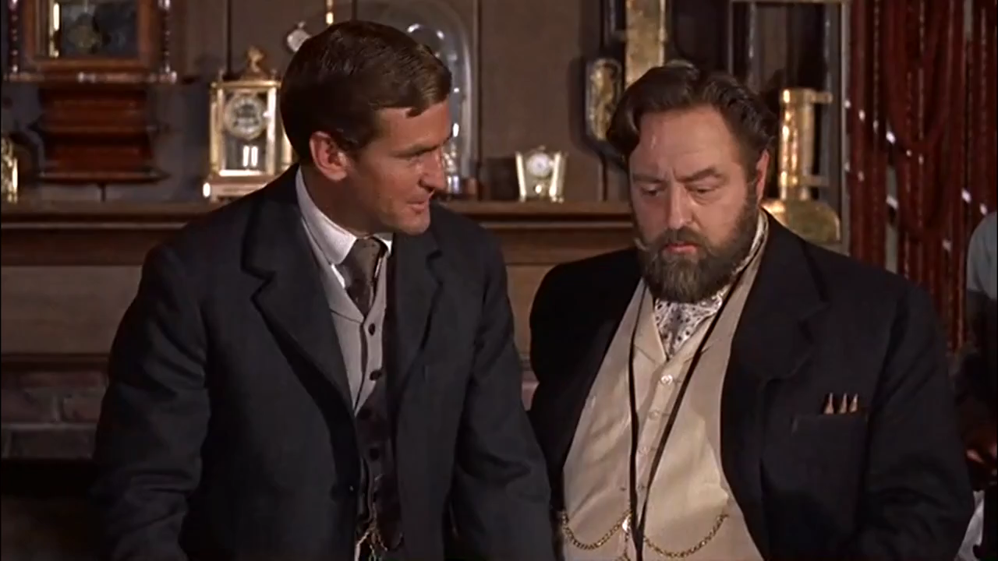
CONTROLLABLE
TIME TRAVEL
Notes:
In this clip, the time traveler can control when he leaves, to what past or future time he goes, how quickly he gets there, and how long he stays there. This is controllable time travel.

Slide 32
UNCONTROLLABLE TIME
TRAVEL: NO PARADOX
If I have no control over my destination time, then I cannot (i.e., I do not have the ability to) travel to 1975: if I do travel to 1975, it will not be as a result of my ability, but instead as a result of forces beyond my control.
So if time travel is uncontrollable, I cannot travel to 1975 (or to any other time), so there is no reason to say that I can kill my younger self, and there is no paradox.
Notes:
If time travel is uncontrollable, or at least if I have no control over my destination time, then I cannot travel to 1975, even if I do end up traveling to 1975. Why? Because to say that I can do something is to say that I have a corresponding ability; but if travelling through time is something that just happens to me, then I have no corresponding ability. If I do end up traveling to 1975, it will not be as a result of my ability: it will be instead as a result of forces beyond my control, as in the clip we watched from The Time Traveler’s Wife. So for uncontrollable time travel there is no reason to say that I can kill my younger self, since I cannot travel to 1975 (or to any other time), and there is no paradox. The paradox relied on two lines of reasoning, with contradictory conclusions: a first line of reasoning, concluding that I can kill my younger self, and a second line of reasoning, concluding that I cannot kill my younger self. My point is that, if time travel is uncontrollable, then the first line of reasoning fails: it’s false that I can kill my younger self. So there is no contradiction, and there is no paradox.

Slide 33
THE WIDE AND THE
NARROW PARADOX
Wide paradox. I cannot kill YS because:
(1) My killing YS would change the past;
(2) I cannot change the past.
Narrow paradox. I cannot kill YS because:
(3) My killing YS is impossible;
(4) I cannot do something impossible.
If my inability to change the past is the whole story, then my inability to kill YS is on a par with my inability to kill (e.g.) Hitler: ‘wide’.
Notes:
Let’s focus then on controllable time travel from now on: let’s assume that I can choose my destination time, so I can travel to 1975 and I can kill my younger self. The paradox, as I said, arises because it also seems that I cannot kill my younger self. I now want to distinguish two versions of the paradox, which correspond to two ways of grounding the claim that I cannot kill my younger self. According to the wide paradox, I cannot kill my younger self because my killing him would change the past, and I cannot change the past. According to the narrow paradox, I cannot kill my younger self because my killing him is impossible, and I cannot do something impossible. Why is it impossible that I kill my younger self? Because he grew up to become me, so if I kill him he must be somehow resurrected, and I assume that resurrection is impossible in the sense of contradicting the laws of physics. Now why the labels ‘wide’ and ‘narrow’? If my inability to change the past were the whole story, then my inability to kill my younger self would be on a par with my inability to do anything inconsistent with the actual past. For example, with my inability to kill Hitler: to kill Hitler would also be to change the past, given that he was not killed by me. But we are not inclined to treat these cases equally: it seems there is something especially problematic when my target is my younger self rather than anyone else. Similarly for the Grandfather Paradox. It seems essential to assume that the time of the contemplated murder is before my father’s conception, but this assumption would be inessential if my inability to change the past were the whole story: killing my grandfather even after my father’s conception would also change the past. So the wide paradox seems to be missing something. In the narrow paradox, by contrast, the fact that my target is my younger self does play a special role. As I said, the idea is that it’s impossible for me to kill him because resurrection is impossible; but no similar impossibility attaches to my killing Hitler for example.
Unfortunately, I only have the time to examine the wide paradox. I can talk about the narrow paradox in the question period if you are interested.

Slide 34
AN ABILITY TO CHANGE THE
PAST IS NOT INCOHERENT
Suppose I can enter a wormhole that leads to 1930 but I choose not to enter. Then I can visit 1930 although I don’t. So I can change the past: I can bring about a nonactual past.
This ability is not incoherent: it’s not an ability to bring it about that there is a first past, in which I don’t visit 1930, and a second past, in which I do.
So the fact that controllable time travel requires an ability to change the past does not show that controllable time travel is impossible.
Notes:
The wide paradox relies on the claim that I cannot change the past. To resolve the wide paradox, I will argue that, properly understood, an ability to change the past is not incoherent. To see this, suppose that there is now a wormhole mouth next to me, and the wormhole leads to the year 1930. Then by entering the wormhole mouth I can visit 1930. Suppose also that I choose to ignore the wormhole mouth, and in our universe I never visit 1930. This does not mean that I cannot do so: clearly I can, since the wormhole mouth is right here, standing next to me. There are plenty of things that I can do but I choose not to do. Since I can enter the wormhole mouth, I can change the past. To say that I can change the past is not to say that I can bring it about that there is a first past, in which I don’t visit 1930, and a second past, in which I do visit 1930: I agree that this is impossible. To say that I can change the past is instead to say that I can bring about a past different from the actual past: I can bring about a past in which I visit 1930. And this I can do, just as I can change the future: I can bring about a future different from the actual future, since I can bring about a future in which I interrupt this talk and I leave this room in the next minute. I will not do this, but my point is that I can. In the actual future, I don’t leave the room in the next minute. But I can bring about a future in which I leave the room, so I can bring about a future different from the actual future, and in this sense I can change the future. Similarly, I can change the past in the sense that I can bring about a past different from the actual past. If I were to enter the wormhole mouth, it’s not that the past would change retroactively. Rather, the past would never have been what it actually is, and would always have been something different. I am not saying that I will change the past: of course I will not, but it does not follow that I cannot. To conclude, an ability to change the past is not incoherent. So the fact that controllable time travel requires an ability to change the past does not show that controllable time travel is impossible. This is my proposed resolution of the wide paradox.

Slide 35
OVERVIEW
I. SINGLE-UNIVERSE TIME TRAVEL
1. Defining Time Travel
2. Three Time Travel Processes
    Time jumps
    Time slides
    Wormholes
3. Two Time Travel Paradoxes
⇒ II. MULTIPLE-UNIVERSE TIME TRAVEL
Notes:
I turn now to the final part of my talk, in which I examine multiple-universe time travel. To remind you, the idea is that there are multiple universes. For example, there is a universe in which I am a biologist―or, more precisely, there is a universe in which a counterpart of mine is a biologist.

Slide 36
FUNDAMENTAL ASSUMPTION
OF MULTIPLE-UNIVERSE TT
If I travel to 1930 in our universe, my plan to kill Hitler will fail. So I plan to travel to 1930 in a different universe and kill Hitler there.
If it’s a random matter to which universe I arrive, then I may end up in the middle of a black hole.
So assume that, whenever one travels from one universe to another, the two universes are parallel until the time of one’s arrival.
Notes:
Let’s go back to my plan to travel to 1930 and kill Hitler. Given what I have said so far in this talk, I realize that my plan should not be to travel to 1930 in our universe. This is because in our universe Hitler did not die in 1930, so if I try to kill him in 1930 in our universe I will fail. So my plan is instead to travel to 1930 in a different universe, and kill Hitler―or rather, his counterpart―in that universe. This would still prevent a lot of evil. But here is a problem with this plan. There are countless universes. In some of them, our whole solar system does not even exist in 1930: there is a black hole in its place. If it’s a random matter to which of these universes I will travel, then who would risk this kind of time travel? Who would risk ending up in the middle of a black hole? So to get a safe kind of multiple-universe time travel let’s assume that, if I travel to 1930, I will end up in a universe that has the same past of 1930 as our universe: Hitler (or rather, a counterpart of his) will still exist there, and he will have done up to 1930 all the things that Hitler has done in our universe up to 1930. So the assumption is that, whenever one travels from one universe to another, the two universes will be parallel until the time of one’s arrival. By “parallel”, I mean that the two universes have the same past, or more precisely qualitatively identical pasts: exactly similar people exist in the pasts of the two universes, and they do exactly similar things. Let’s call this the “fundamental assumption of multiple-universe time travel”.
Some time travel stories and movies deviate from the fundamental assumption: they show time travelers who arrive at a universe with a past slightly different (or even very different) from the past of their departure universe. There need not be anything wrong with such stories, but my point is that this kind of time travel is like playing Russian roulette: you may end up in the middle of a black hole and get killed. So I will focus in the remainder of my talk on the kind of multiple-universe time travel for which the fundamental assumption is true: when you travel to another universe, it is guaranteed that, up to the time of your arrival, the past history of that universe will be indistinguishable from the past history of your departure universe.

Slide 37
MULTIPLE-UNIVERSE TIME
TRAVEL: A ONE-WAY TICKET
Hitler does I enter a time
Universe #1 not die machine
(our universe) 1930 2018
I kill
Universe #2 Hitler
1930 2018
From 1930 in universe #2, I will not go back to 2018 in universe #1: the universes are not parallel until the time of my intended arrival (2018).
Notes:
Suppose then that the fundamental assumption is true, and I start from 2018 in our universe and travel to 1930 in another universe. Things are there just as in my departure universe: Hitler exists (or rather a counterpart of Hitler exists), and he is planning to do a lot of awful things. Suppose further that I kill him. What I want to explain now is that there is no way I will go back to 2018 in our universe. To see this, call our universe “Universe #1”, and call the universe in which I kill Hitler “Universe #2”. If I travel from Universe #2 to 2018 in Universe #1, then, by the fundamental assumption, the past of 2018 will be the same in the two universes. But the past of 2018 is not the same in the two universes, since Hitler is killed in 1930 in Universe #2 but Hitler is not killed in 1930 in Universe #1. It follows that I will not travel from 1930 in Universe #2 to 2018 in Universe #1: I will not go back to where I came from. Multiple-universe time travel to the past is a one-way ticket: there is no return if the fundamental assumption is true.

Slide 38
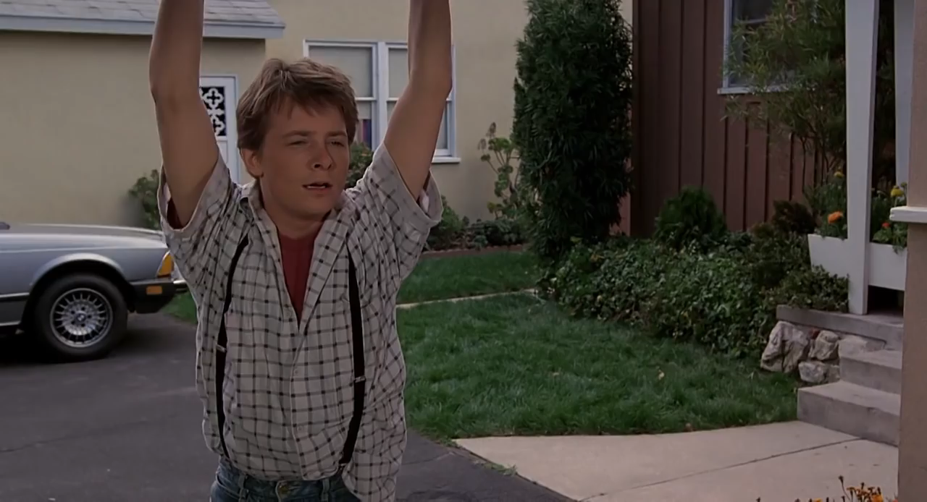
A BETTER FUTURE?
Notes:
To summarize, if the fundamental assumption is not true, then multiple-universe time travel is like playing Russian roulette, and if the fundamental assumption is true, then multiple-universe time travel to the past is a one-way ticket. But now suppose I want a one-way ticket. Suppose I don’t like our universe, a universe in which the Holocaust occurred. I want to live in a different universe, in which the Holocaust doesn’t occur. So, after killing Hitler in Universe #2, I travel to 2018 in that universe. Suppose that 2018 in that universe is indeed much better that 2018 in Universe #1: in 2018, the world is much more peaceful and civilized in Universe #2 than in Universe #1. Should I be happy then? Not necessarily. The problem is that in Universe #2 I am a stranger: I have no family, no job, no place to live. I’m a time traveler from a different universe. Sometimes time travel stories try to avoid this problem by assuming that in Universe #2 I still have a family and a home, only they are better than what I had in Universe #1. Here is an example, from the movie Back to the Future.

Slide 39
NO BETTER FUTURE
Marty #1 enters
Universe #1 a time machine
1955 1985
Marty #1 Marty #1 meets
Universe #2 arrives Jennifer #2
1955 1985
What happens to Marty #2 in 1985? Does he suddenly disappear?
Notes:
In this movie, Marty travels first from 1985 to 1955. Certain things happen there which did not happen in the original 1955: for example, his mother, who is at that time a young girl, starts falling in love with him. So he is not in 1955 in his departure universe: he is instead in 1955 in another universe, Universe #2. Then he travels to the future, to 1985, and he finds things there much better than in the year 1985 of Universe #1: in the clip we just watched, he finds out that he has a much better car than he had in 1985 in Universe #1. The problem is that this car does not belong to him. When did he acquire it? It was never given to him. Presumably, it was given to his counterpart in Universe #2, call him Marty #2. In fact, in the clip we just watched, Jennifer says “You act like you haven’t seen me in a week”, so clearly Jennifer is not Marty’s girlfriend: she’s the girlfriend of his counterpart, Marty #2, whom she has been seeing in the last week. The movie has the flaw that we never see the counterpart: he must mysteriously disappear when the time-traveling Marty appears. If we had seen the counterpart, the problem that I am raising would have been obvious: the time-traveling Marty is a stranger in Universe #2 and has no family, no car, no girlfriend.
To summarize, multiple-universe time travel is no pleasant matter: either you play Russian roulette, or you get a one-way ticket to a universe in which you are a stranger.

Slide 40
CONCLUSIONS
There are many kinds of time travel: Multiple- vs single-universe; uncontrollable vs control-lable; by time jumps, time slides, or wormholes.
Some kinds of time travel deserve more serious attention than others. Time jumps and time slides are problematic, but wormhole time machines are taken seriously by physicists.
The paradoxes of time travel do not show time travel to be impossible. For example, an ability to change the past is not incoherent.
Notes:
To conclude, here are three take-home messages that I hope you will remember from this talk. First, there are many kinds of time travel: multiple-universe versus single-universe time travel, uncontrollable versus controllable time travel, and time travel by time jumps, time slides, or wormholes. Second, some kinds of time travel deserve more serious attention than others. As we saw, time jumps and time slides are problematic, so they are not considered seriously by physicists. By contrast, wormhole time machines are seriously discussed in leading physics journals. Third, the paradoxes of time travel do not show time travel to be impossible. For example, I argued that an ability to change the past is not incoherent. I did not fully defend this third conclusion, because I did not have the time to examine all time travel paradoxes. But we can talk more about the paradoxes in the question period if you are interested.

Slide 41
TIME TRAVEL IN
SPECIAL RELATIVITY
Something travels to the past if and only if all observers agree that its arrival is earlier than its departure. (I.e., its arrival is in the interior of the past light cone of its departure.)
Something travels to the future if and only if all observers agree that the stopwatch duration (i.e., proper length) of its trip is shorter than the external duration of its trip. (I.e., its arrival is in the interior of the future light cone of its departure, and the trip is not a straight line.)

Slide 42
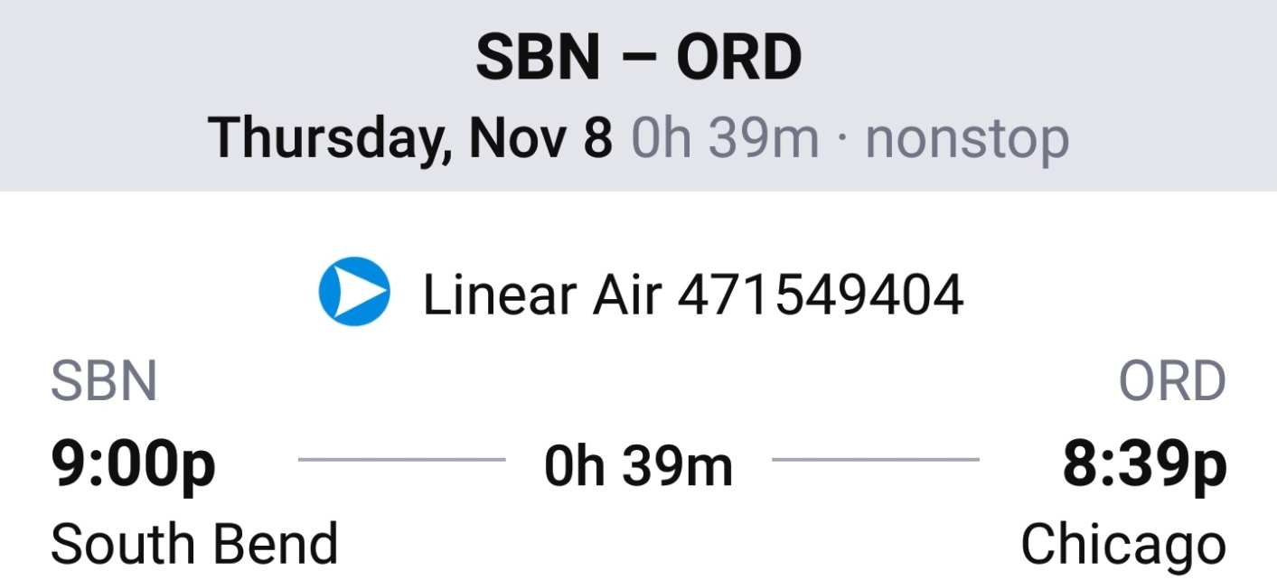
A PROBLEM WITH THE
PRELIMINARY DEFINITION
Departure from South Bend, Indiana (Eastern time zone): 9:00 pm. Arrival to Chicago (Central time zone): 8:39 pm.
Arrival time is earlier than departure time, but this is not time travel to the past.
Notes:
To see the problem, note that tonight (Thursday, November 8) one can board a flight at 9pm in South Bend, Indiana, which is in the Eastern time zone, and one can arrive at 8:39pm in Chicago, which is in the Central time zone. Although the arrival time, 8:39pm, is earlier than the departure time, 9pm, this is not time travel to the past, because the two times refer to different time zones.

Slide 43
TIME TRAVEL TO THE PAST:
A BETTER DEFINITION
Disagreement on departure and arrival times, but agreement that arrival is later than departure.
Better definition: Something travels to the past if and only if all observers agree that its arrival is earlier than its departure.
 | Departure time | Arrival time | Is arrival later than departure?
South Bend observer | 9:00 pm | 9:39 pm | Yes
Chicago observer | 8:00 pm | 8:39 pm | Yes
Notes:
To avoid this problem with the preliminary definition, note that observers in different time zones disagree on the departure and arrival times of the flight, but agree that its arrival is later than its departure. More specifically, an observer located in South Bend and an observer located in Chicago will disagree about your arrival time: an observer located in South Bend will say that you arrive at 9:39pm, but an observer located in Chicago will say that you arrive at 8:39pm. Nevertheless, both observers will agree that your arrival is later than your departure (9:39 versus 9, and 8:39 versus 8), so this is not time travel to the past. Here is then a better definition: something travels to the past if and only if all observers agree that its arrival is earlier than its departure. Physicists may have an objection: according to the Special Theory of Relativity, whether an event is earlier or later than another is in general a relative matter. In some cases, your arrival is earlier than your departure according to one observer, but your arrival is later than your departure according to another observer. I reply that this can happen only you travel faster than light; this is impossible according to the Special Theory of Relativity, so I will ignore this complication in what follows.

Slide 44
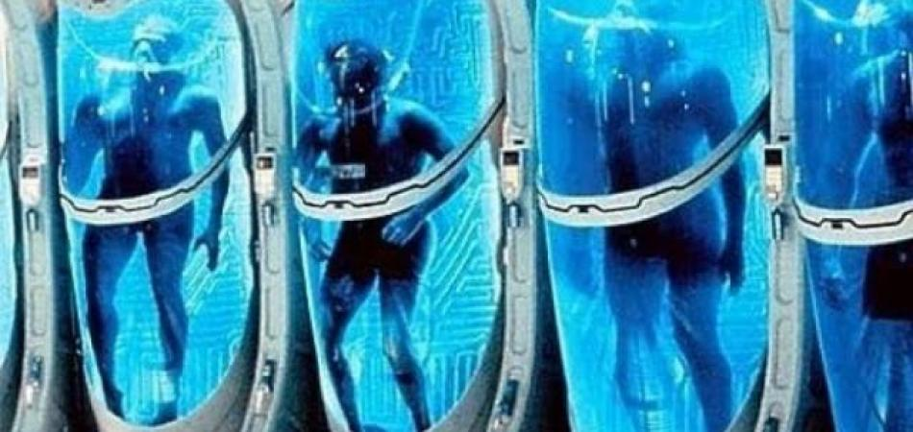
CRYOGENIC FREEZING
Notes:
People who want to travel to the future may decide to have their bodies cryogenically frozen now and thawed out many years later. Is this a means of time travel to the future?

Slide 45
CRYOGENIC FREEZING:
NO TIME TRAVEL
If you are frozen in 2000 and thawed out in 3000, the stopwatch duration of your trip is 1000 years, not 0: this is not time travel to the future.
Time machine: A 30-year old woman enters in 2000 and exits in 3000. She is still 30 years old.
Cryogenic freezing: A 30-year old woman is frozen in 2000 and thawed out in 3000. She is 1030 years old, although she has the body of a 30-year old woman.
Notes:
It is not. To see this, note that the stopwatch duration of a trip may be unrelated to how much the traveler ages during the trip. Suppose that in the year 2000 you are cryogenically frozen and you are thawed out in the year 3000, not having aged at all. The stopwatch duration of your trip is not zero: it is instead a thousand years, because this is the length of time that would be measured by a properly functioning (and thus unaffected by freezing) stopwatch accompanying you on your trip. Since the stopwatch duration of this trip is the same as its external duration, namely one thousand years, this is not a case of time travel to the future according to the definition I gave. I think that this result is correct: cryogenic freezing is not a means of time travel to the future. It’s true that, from the perspective of the traveler, the case of cryogenic freezing and the case of the time machine look very similar: in both cases, the traveler experiences hardly any time passing, but finds himself or herself in the future. Nevertheless, from an external perspective, the two cases are very different. The 30-year old woman who enters a time machine in the year 2000 and exits in 3000 is still 30 years old if the stopwatch duration of the trip is a few seconds. By contrast, the 30-year old woman who is cryogenically frozen in the year 2000 and thawed out in 3000 is no longer 30 years old: she is 1,030 years old, since she has been continuously alive for 1,030 years, although she has the body of a 30-year old woman. This is why cryogenic freezing is not a means of time travel.

Slide 46
SUMMARY OF DEFINITIONS
Arrival later than departure: travel forwards.
Arrival earlier than departure: travel backwards.
Stopwatch duration shorter than external duration: travel quickly.
Traveling | Quickly | At normal speed | Slowly
Forwards | TT to the future | Ordinary travel | Slow travel forwards
Backwards | Quick TT to the past | Normal-speed TT to the past | Slow TT to the past
Notes:
To summarize, two questions are relevant to defining time travel. First, is the arrival later or earlier than the departure? If the arrival is later than the departure, then one travels forwards; if the arrival is earlier than the departure, then one travels backwards. Second, is the stopwatch duration of the trip shorter than, equal to, or longer than the external duration of the trip? If the stopwatch duration is shorter that the external duration, then one travels quickly; if the stopwatch duration is longer than the external duration, then one travels slowly; and if the two durations are equal, then one travels at normal speed. We saw that traveling forwards at normal speed corresponds to ordinary travel, not to time travel to the future. Only traveling forwards quickly counts as time travel to the future. By contrast, any kind of traveling backwards counts as time travel to the past, so there are three kinds of time travel to the past: quick, slow, and at normal speed. We see then that there is an asymmetry between the definitions of time travel to the past and time travel to the future.

Slide 47
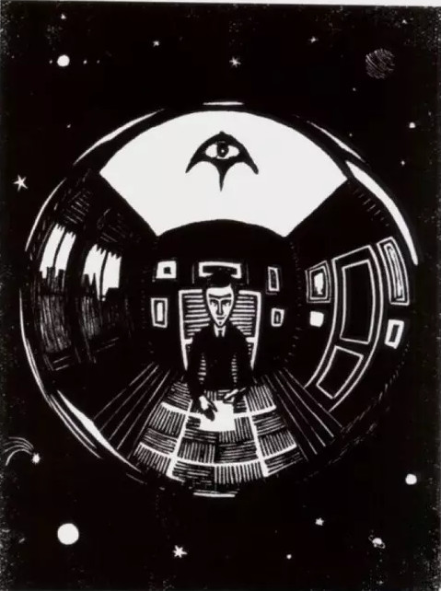
A VERY SHORT WORMHOLE
This is a wormhole mouth in deep space.
The other wormhole mouth is in a room on Earth.
The wormhole tunnel is very short, so from deep space one can see the room on Earth.
Notes:
In this clip, the trip takes a while. By contrast, if the wormhole tunnel is very short, then the trip can take only a couple of seconds, and when you approach one of the wormhole mouths you can see what is outside the other mouth. Here is an example. In this print by Escher, we see a wormhole mouth in deep space. The other wormhole mouth is in a room on Earth, and the wormhole tunnel is very short, so those who approach the wormhole mouth in deep space can see what is outside the other mouth, namely the room on Earth.

Slide 48
IS IT CONSISTENT TO
ASSUME I GO BACK TO 1930?
I did not exist in 1930, so it’s contradictory to say I go back. -But assume I did exist in 1930.
Internal perspective: In 2018 I enter TM in Madison. After two minutes I emerge from TM in Berlin in 1930. I shoot Hitler. I enter TM in Berlin. I emerge from TM in Madison in 2018.
External perspective: In 1930 a man emerges from TM in Berlin, shoots Hitler, and enters TM in Berlin. A man is born in 1965; enters TM in Madison in 2018; reappears shortly afterwards.
Notes:
Some people may think that my story so far is inconsistent: I did not exist in 1930, so by saying that I enter a time machine and go back to 1930 I am saying that I both do and do not exist in 1930, a contradiction. I don’t need to do anything in 1930, like killing Hitler; my mere presence there is enough for a contradiction, since I was not there--or so the objection goes. In reply, recall that I am still assuming there is only one universe, with a single timeline. I am not saying that there is a first time around in which I don’t exist in 1930 and a second time around in which I do exist. I am rather assuming that there is a single 1930, and that I did exist there. Yes, I was born in 1965, but it doesn’t follow that I did not exist in 1930. Do we know everything that happened all around the world in 1930? For all we know, the events of 1930 may already include the unnoticed arrival of a time traveler from the future, namely me.
Some people might reply: if you had existed in 1930, then you would have been almost 90 years old now. But we know that you are not 90 years old, so we know you didn’t exist in 1930. Well no, that’s another misunderstanding. Look, one can tell the story from two different perspectives. First, from my own perspective: I enter a time machine in Madison in 2018, when I’m 53 years old, and after two minutes as measured by my watch I exit the time machine in Berlin in 1930. I am still 53 years old. I shoot Hitler, I miss, I enter the time machine in Berlin in 1930, and after two minutes as measured by my watch I exit the machine in Madison in 2018. I am still 53 years old. Now here is the story from an external perspective. In 1930, a 53-year-old man emerges from a time machine in Berlin, shoots Hitler, misses, and then enters the time machine and disappears. In 1965 a man is born, grows up to be 53 in 2018, enters a time machine in Madison, disappears, and reappears out of the machine shortly afterwards, still being 53 years old. The story is perfectly consistent, and all this is well understood. What is not well understood is what I can do in 1930: on the one hand it seems I can kill Hitler since I am facing him with a gun, but on the other hand it seems I cannot kill him because I cannot change the past. What I’m saying is that the second line of reasoning is flawed, because to kill Hitler in 1930 would be to change the future of 1930, and in 1930 I can change the future--even if not the past--of 1930.

Slide 49
RESOLVING THE
WIDE PARADOX
The reasoning:
(1) To kill Hitler would be to change the past.
(2) I cannot change the past.
Thus: (3) I cannot kill Hitler.
The past of what?
(1) To kill Hitler in 1930 would be to change the past of 2018 [but the future of 1930].
(2) In 1930 I cannot change the past of 1930 [but I can change the future of 1930].
Notes:
As I just said, for the wide paradox it doesn’t matter whether we talk about my killing my younger self or about my killing for example Hitler. So, to avoid distracting issues having to do with resurrection, let me just talk about killing Hitler.
The reasoning of the wide paradox is simple: to kill Hitler would be to change the past, given that he was not killed by me; but I cannot change the past; so I cannot kill Hitler. Here is my response. Suppose that I enter a time machine in the year 2018, I go back to 1930, and then I face Hitler. Consider two questions one might ask. First, can I now, in 2018, kill Hitler? Second, can I in 1930 kill Hitler? Let’s focus for the moment on the second question, whether in 1930 I can kill Hitler. To kill Hitler in 1930 would be to change the past of 2018 but the future of 1930. Even if in 1930 I cannot change the past of 1930, why can’t I change the future of 1930? So the reasoning of the wide paradox looks plausible because the expression ‘the past’ is ambiguous. In the first premise (“to kill Hitler would be to change the past”) we are talking about the past of 2018. In the second premise (“I cannot change the past”) we are talking about the past of 1930, since we are focusing for the moment on the question of whether in 1930 I can kill Hitler. If in 1930 I can change the future of 1930, then in 1930 I can kill Hitler. But can I change the future? Sure, I can raise my arm even though I will not. This is not to say that I can bring about a logically impossible state of affairs in which I both do and do not raise my arm at some future moment. It is rather to say that I can bring about a nonactual future, a future in which I do raise my arm. Similarly, in 1930 I can kill Hitler in the sense that I can bring about a nonactual future of 1930, a future in which, for example, Poland is not invaded by Germany. I conclude that in 1930 I can kill Hitler--or, more precisely, that the wide paradox gives us no good reason for thinking that I cannot.

Slide 50
CAN I NOW KILL HITLER?
I cannot now kill Hitler: now I cannot change the past of 2000, even if in 1930 I can.
Where is the problem? It’s in 1930 that I am facing Hitler and thus I can kill him.
One might argue: now I can kill Hitler because (1) now I can go back to 1930 and (2) in 1930 I can kill Hitler.
I reply: whether now I can go back to 1930 depends on whether time travel is controllable or uncontrollable.
Notes:
OK, suppose you accept that in 1930 I can kill Hitler. What about the other question: can I now kill him? It seems not: to kill him would be to change the past of 2018, and now I cannot change the past of 2018, even if in 1930 I can. In reply I ask: so what? Ability is in general time relative: what I can do at one time I cannot always do at a later time. For example, in the morning I can keep my evening appointment but in the afternoon I cannot: I missed the plane at noon. Similarly, in 1930 I can kill Hitler but now I cannot--where’s the problem? The paradox arises with respect to 1930: it’s in 1930 that I am facing Hitler with a gun, so that there is reason for saying I can kill him. Now I’m no longer facing him, so there is no corresponding reason for saying I can kill him.
In response one might argue that there is a reason for saying that now I can kill Hitler: now I can go back to 1930, and in 1930 I can kill him. I reply that whether now I can go back to 1930 depends on what kind of time travel we are talking about. Distinguish two extreme kinds of time travel: fully uncontrollable time travel, and fully controllable time travel. Here is an example of fully uncontrollable time travel.

Slide 51
RESOLVING THE
NARROW PARADOX
Narrow paradox. I cannot kill YS because:
(N1) My killing YS is impossible;
(N2) I cannot do something impossible.
N1 relies on:
(N3) Resurrection is impossible;
(N4) It is impossible that YS coexists with me without being an earlier stage of mine.
If N4 is false, then the paradox is resolved.

